Slide 1

Indirect Tax
Consultancy
By Siddharth Mehta N021 and Nischaya Sharma N036

Slide 2
INTRODUCTION
GST(Goods and Services Tax) now has become the only tax in our country
It was implemented in the year 2017
Due to the short time period many people don't know about its applications and have many doubts regarding it.
People search their doubts over the internet from various websites and just scratch their heads over it.
And hence, we have proposed a solution to make a website
In which users can login using their personal account and can ask any question regarding the GST implementation which would be answered by a specialized team using a GUI

Slide 3
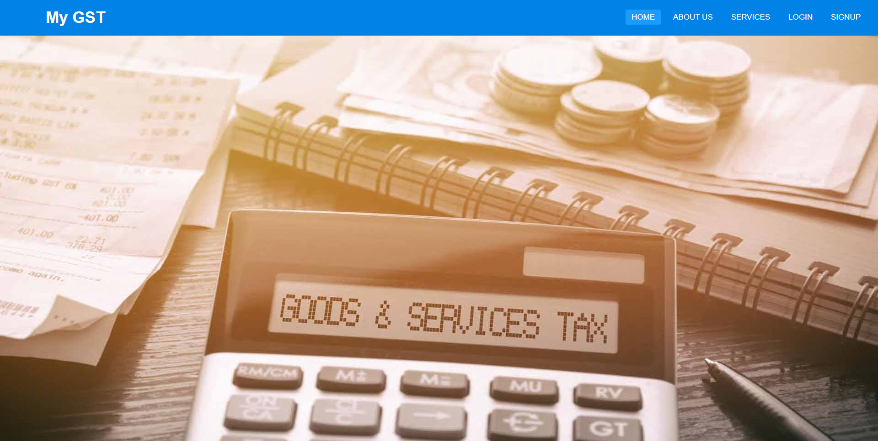
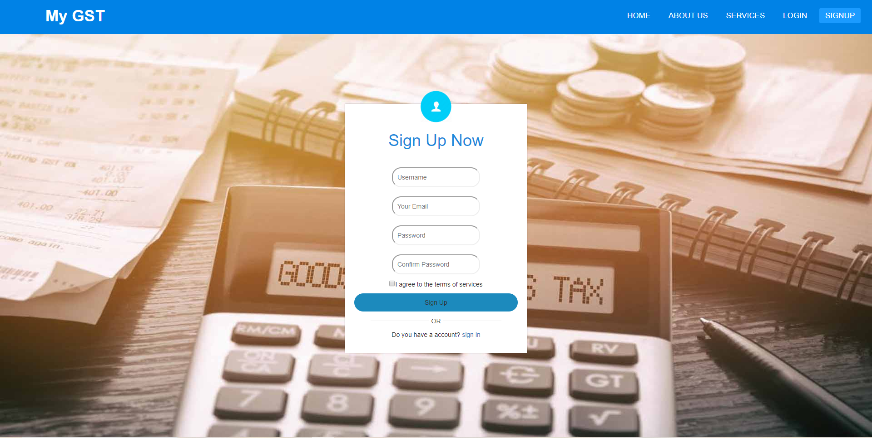
LAYOUTS (UI DESIGN)/VISUALIZATION
HOME PAGE
Signup Page

Slide 4
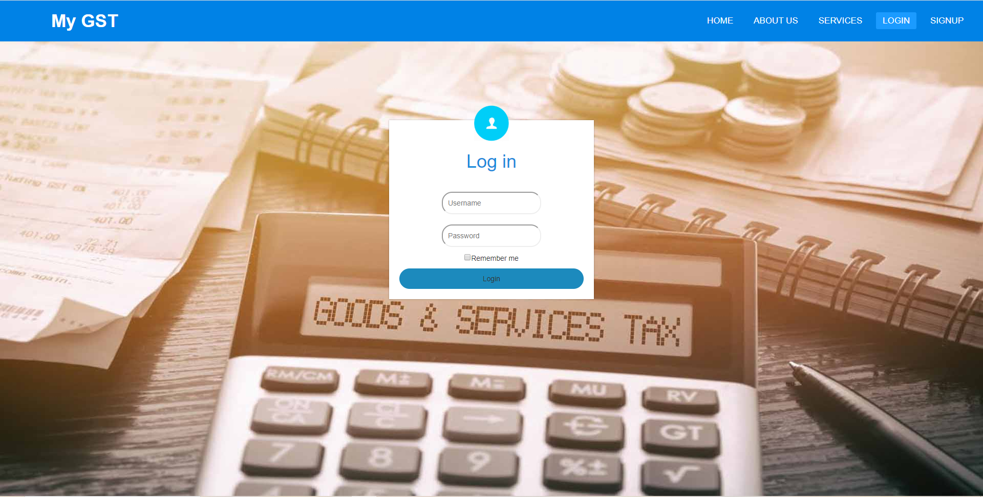
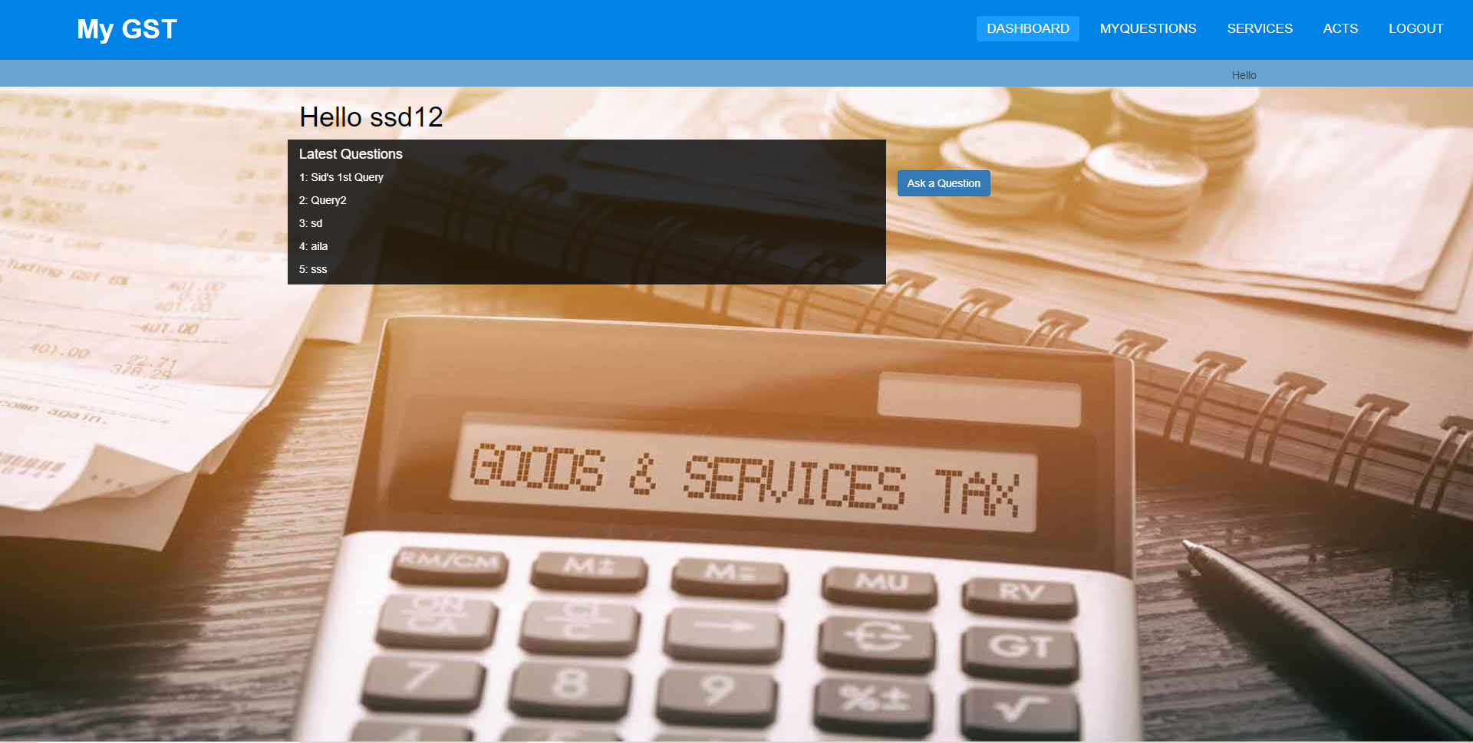
LAYOUTS (UI DESIGN)/VISUALIZATION
Login Page
Dashboard

Slide 5
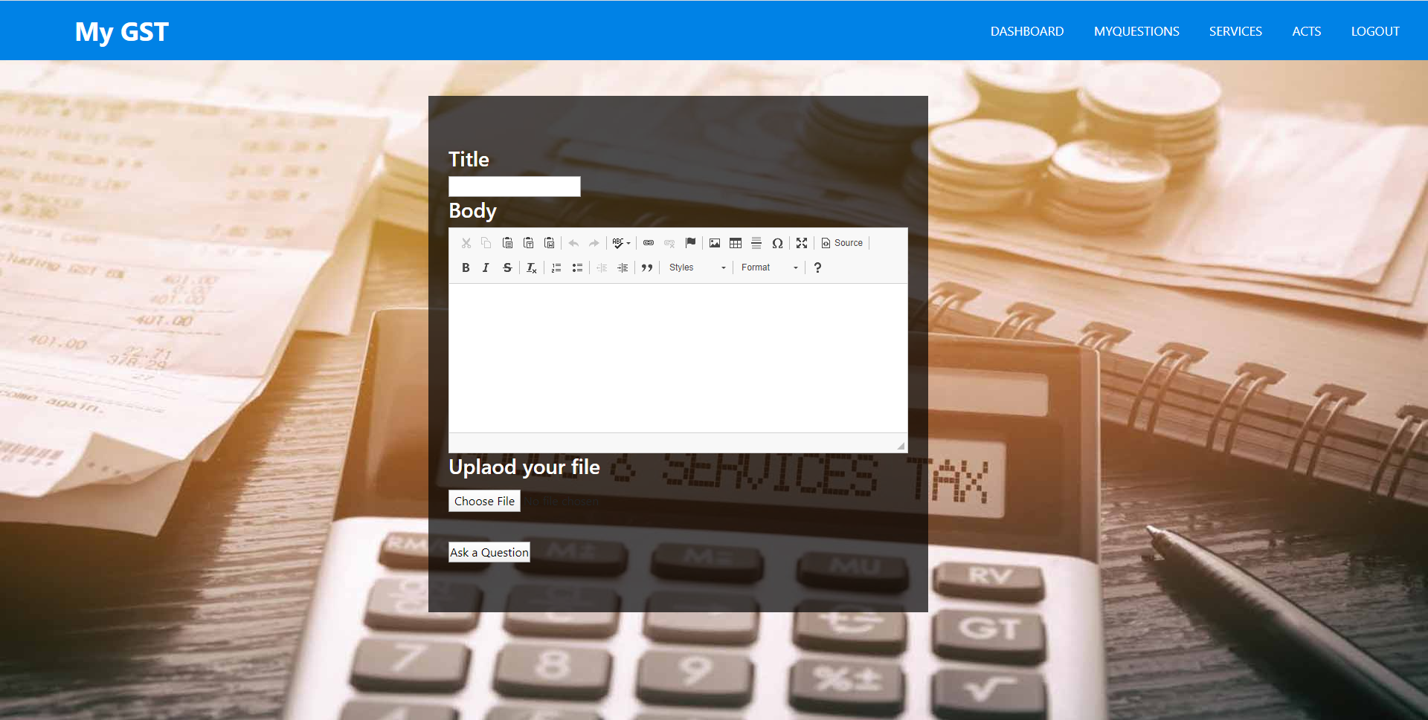
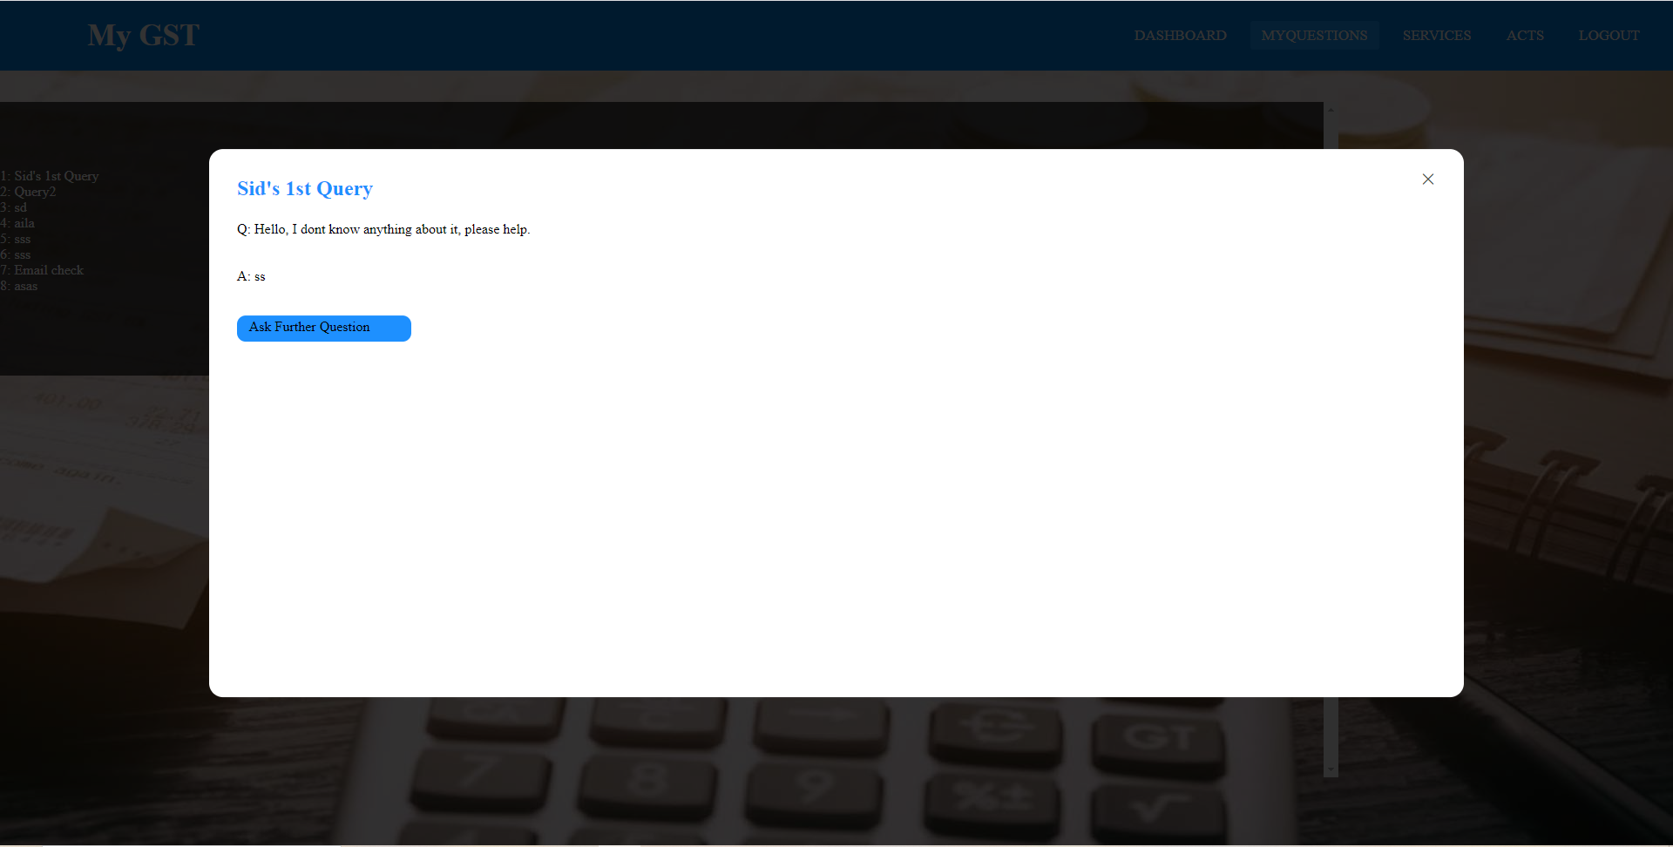
LAYOUTS (UI DESIGN)/VISUALIZATION
Ask question page
Per question modal

Slide 6
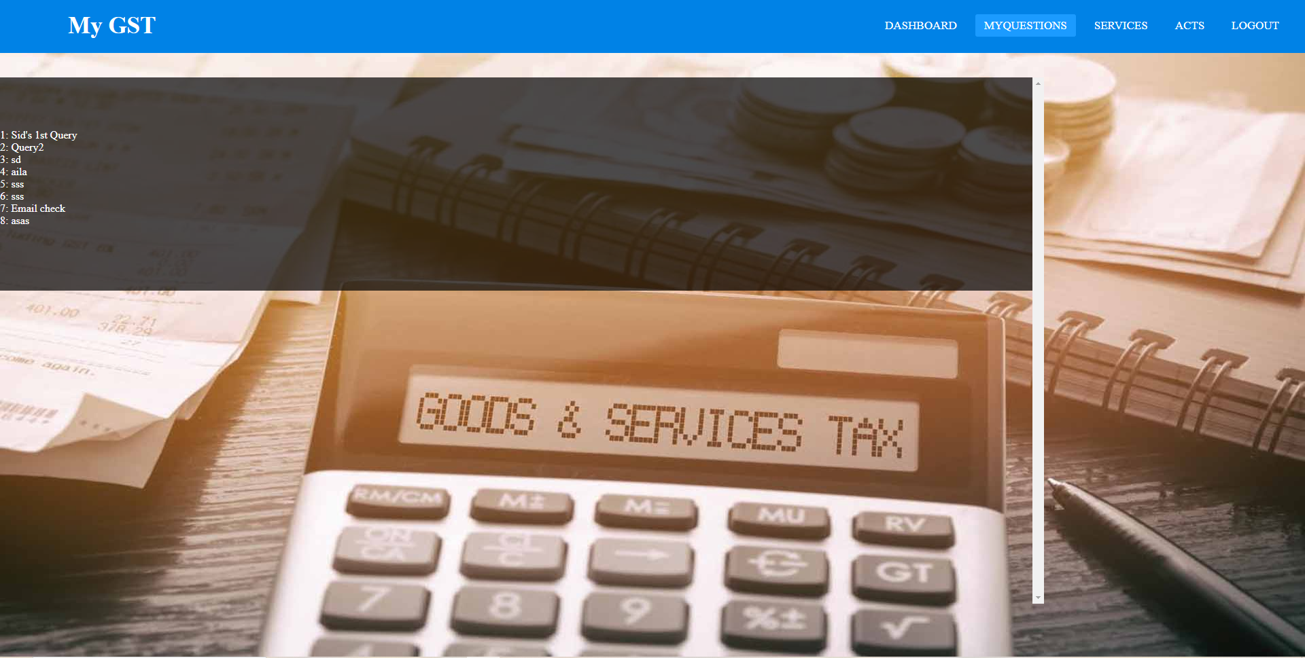
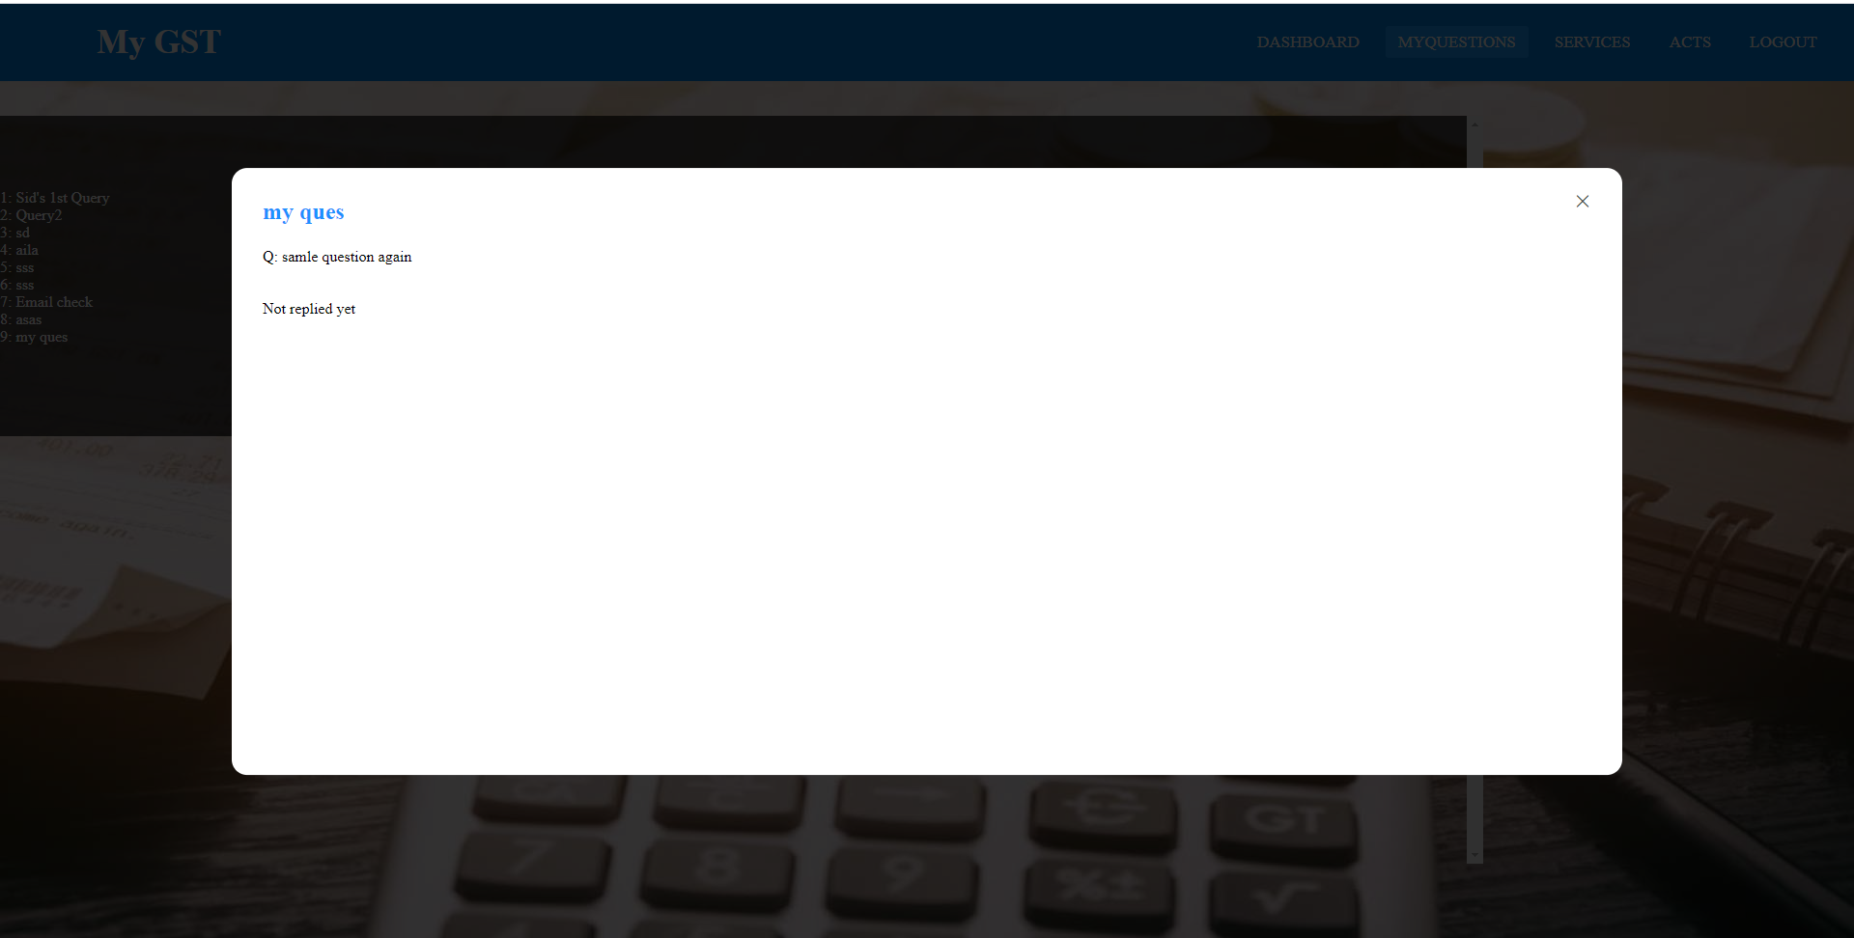
LAYOUTS (UI DESIGN)/VISUALIZATION
My Questions
Not Replied Query

Slide 7
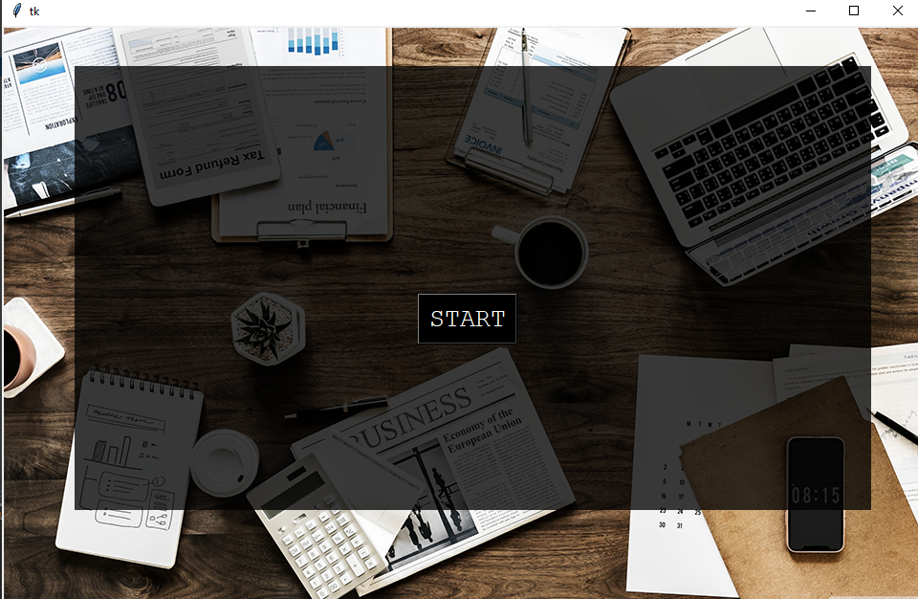
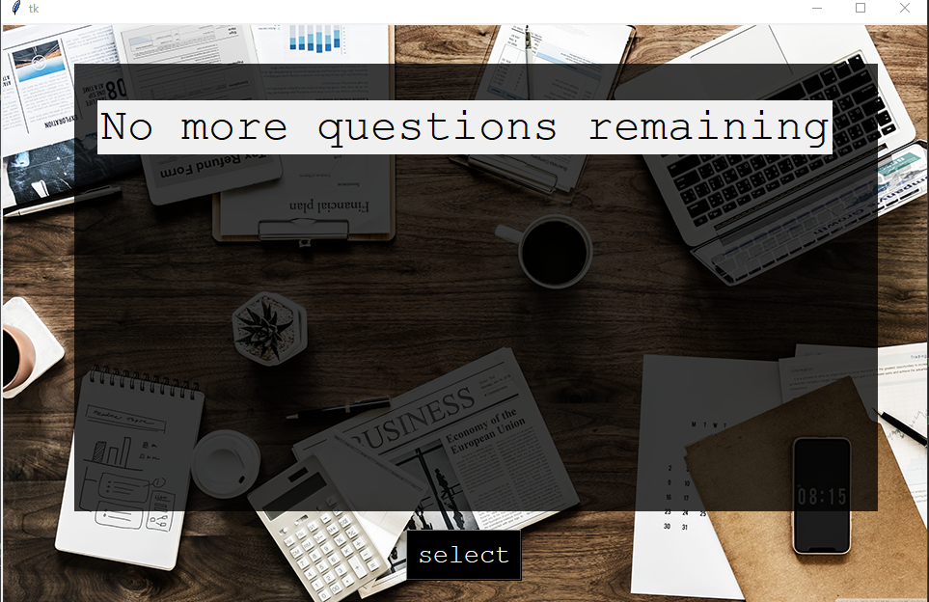
LAYOUTS (UI DESIGN)/VISUALIZATION
Start Window
No Question Window

Slide 8
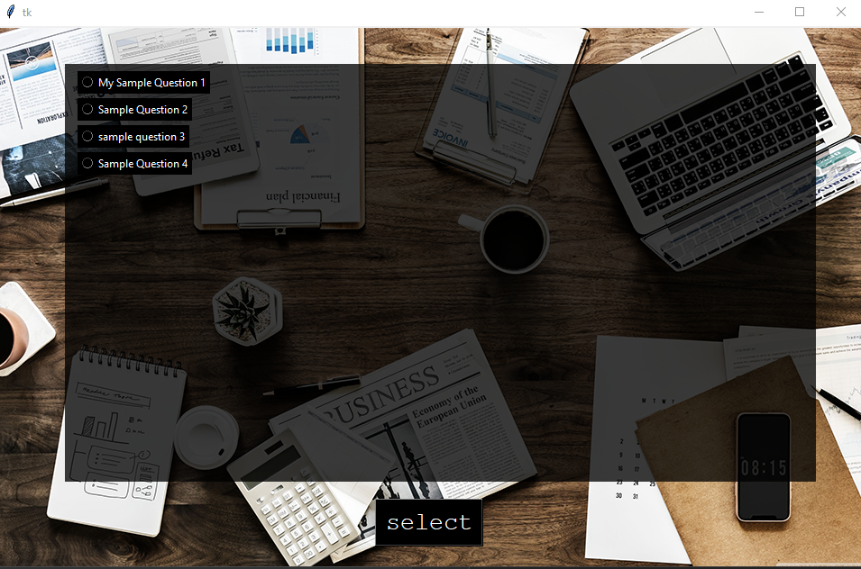
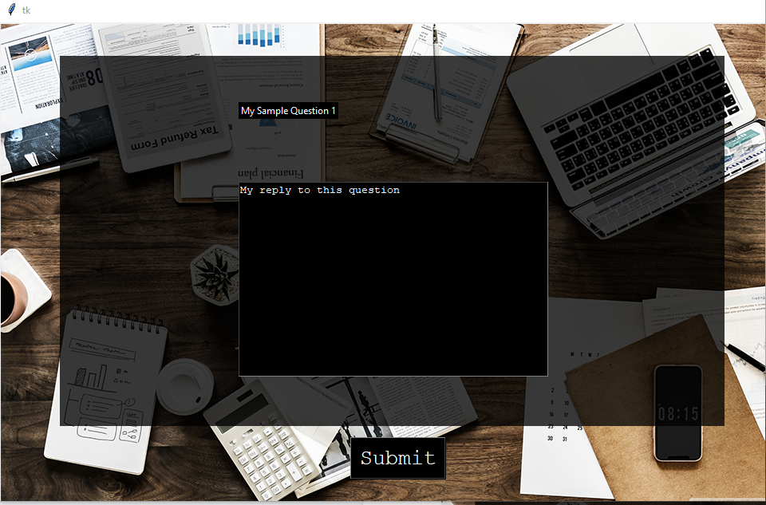
LAYOUTS (UI DESIGN)/VISUALIZATION
All Questions Window
Reply Window

Slide 9
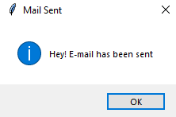
LAYOUTS (UI DESIGN)/VISUALIZATION
Mail Sent Message Box

Slide 10
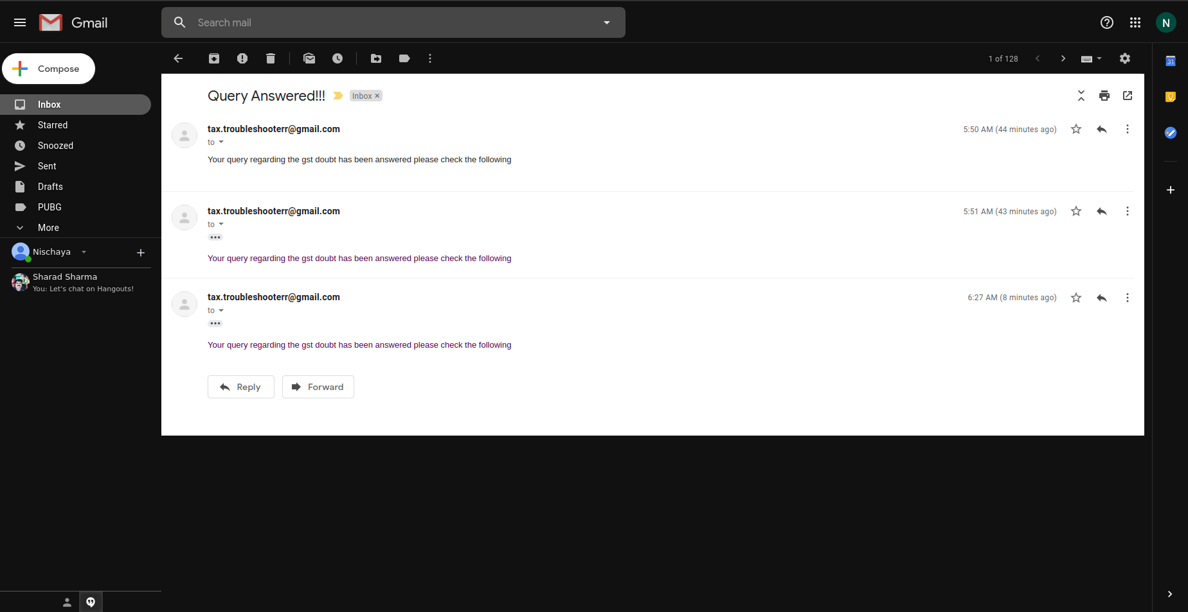
LAYOUTS (UI DESIGN)/VISUALIZATION
Query Answered E-Mail

Slide 11
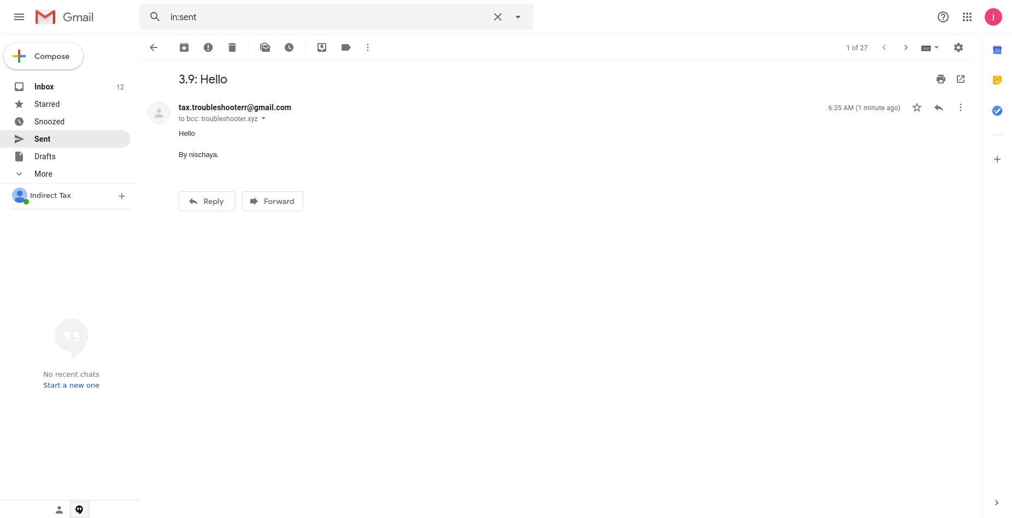
LAYOUTS (UI DESIGN)/VISUALIZATION
Query Raised E-mail Sent to out troubleshooting team

Slide 12
TECHNICAL CONTENT
JAVASCRIPT
FLASK
SQLALCHEMY
We have used JS for extracting elements from Html and passing it to Flask via JSON and vice versa
We have used flask as a backend for our website
We have used SQLAlchemy in python for our DataBase Management System

Slide 13
TECHNICAL CONTENT
HTML5
CSS
BOOTSTRAP
We have used html for elemental structuring of the website
We have used CSS3 for designing our web pages.
We have used Bootstrap for making our web pages more user friendly.

Slide 14
TECHNICAL CONTENT
PYTHON ~TKINTER
SQLITE3
We have used html for elemental structuring of the website
We have used CSS3 for designing our web pages.

Slide 15
LINKING AND IMPLEMENTATION WITH DEMO
http://127.0.0.1:5000/

Slide 16
CONCLUSION
As a conclusion we have made a website where user can ask queries related to GST.
Also we have made a GUI where the experts can answer the queries asked by the Users
This website would thus help the users in solving their doubts
People who would be majorly benefited from this website are CA's,Teachers,Students,etc
Also the website shows the updated acts related to GST.

Slide 17
Thank You

